Slide 1

Regression and Classification in Supervised Machine Learning
Analysis of Heart Disease and Car Details Datasets
Chandana T M
DA/DS batch 28

Slide 2
Introduction
Supervised machine learning utilizes labeled data to train models that can make predictions. This report explores two key types of supervised learning: regression and classification, using the Heart Disease dataset for classification and the Car Details dataset for regression. the Heart dataset for predicting cardiovascular disease and the Car dataset for classifying car features. The goal is to demonstrate the efficiency of various algorithms and provide insights into model performance.

Slide 3
Objectives
To analyze the Heart Disease dataset for binary classification of heart disease presence.
To apply regression techniques to predict car prices using the Car Details dataset.
To evaluate model performance using appropriate metrics.

Slide 4
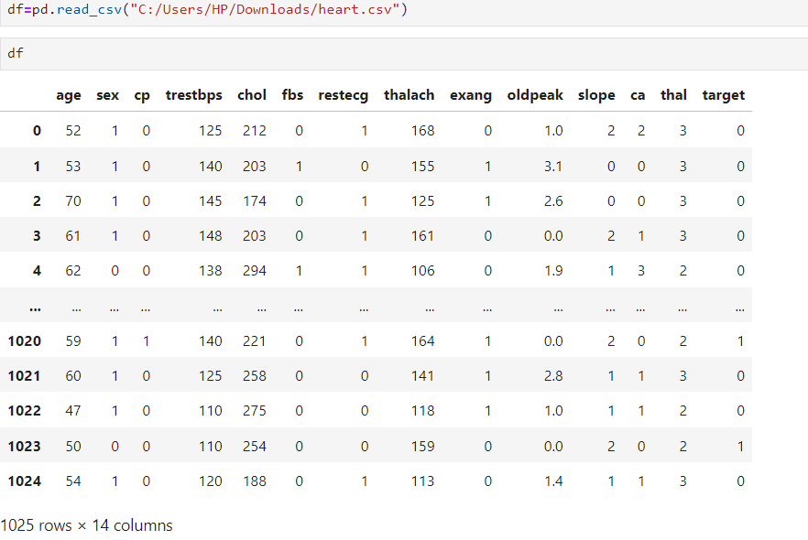
Datasets
1. Heart Disease Dataset
Description: Contains information about patients, including medical attributes and whether they have heart disease.
Key Features: Age, sex, chest pain type, resting blood pressure, cholesterol levels, etc

Slide 5
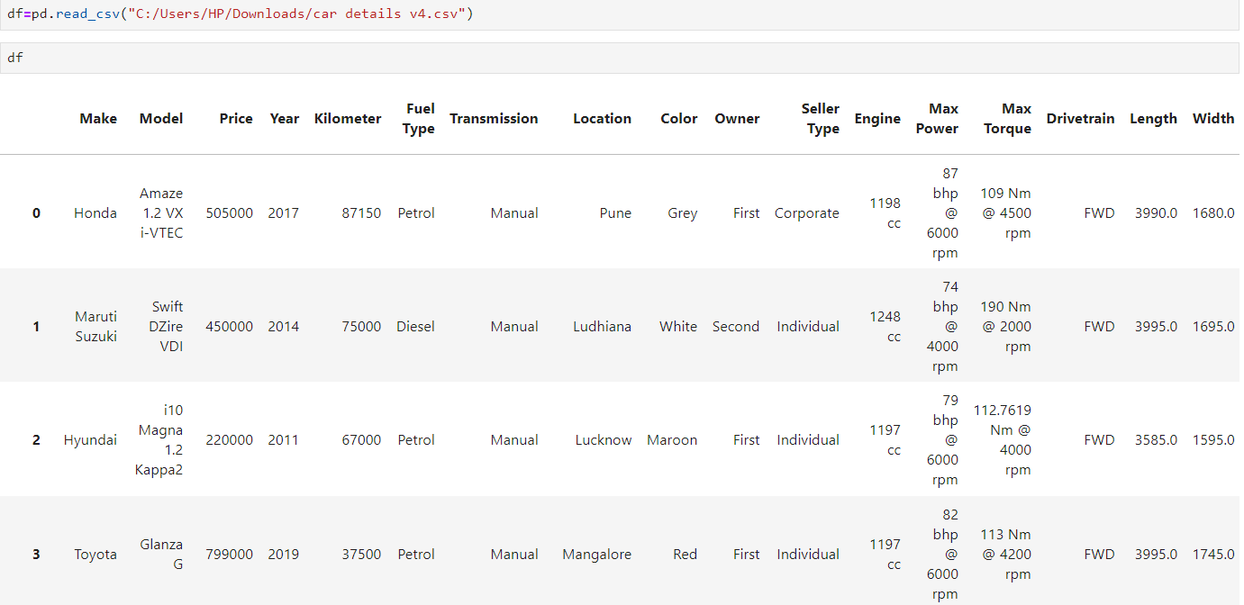
2. Car Details Dataset
Description: Contains details about various cars, including their features and prices.
Key Features: Make, model, year, mileage, engine size, etc.

Slide 6
Classification
Classification in machine learning is a supervised learning task where the goal is to predict the categorical label of new observations based on a training dataset.
Classification involves assigning a class label to input data based on learned patterns from labeled training data.
Common Algorithms
Logistic Regression:
Used for binary classification. It models the probability that a given instance belongs to a particular class.
2.Decision Trees:
A tree-like model that makes decisions based on feature values. It's easy to interpret but can be
prone to overfitting.

Slide 7
3.Random Forest:
An ensemble method that combines multiple decision trees to improve accuracy and reduce overfitting.
4.Support Vector Machines (SVM):
Finds the optimal hyperplane that separates classes in high-dimensional space, effective for both linear and non-linear data.
5.K-Nearest Neighbors (KNN):
Classifies instances based on the majority class among the k-nearest training samples.

Slide 8
Classification: Heart Disease Prediction
Data Preprocessing
Handling Missing Values: Check for null entries and imputed or removed as necessary.
Encoding Categorical Variables: Used one-hot encoding for categorical features.
Feature Scaling: Standardized numerical features.
Model Selection
Logistic Regression: Baseline model for binary classification.
Decision Tree Classifier: For capturing non-linear relationships.
Random Forest Classifier: Ensemble method to improve accuracy.

Slide 9
Applications
--------------------------------------------------------------------------------------------------------------------------------------------------------------------------------------
Spam Detection: Classifying emails as spam or not spam.
Sentiment Analysis: Determining whether a text expresses a positive, negative, or neutral sentiment.
Image Recognition: Classifying images into categories (e.g., identifying objects in photos).
Medical Diagnosis: Classifying patient data to predict the presence of diseases.

Slide 10
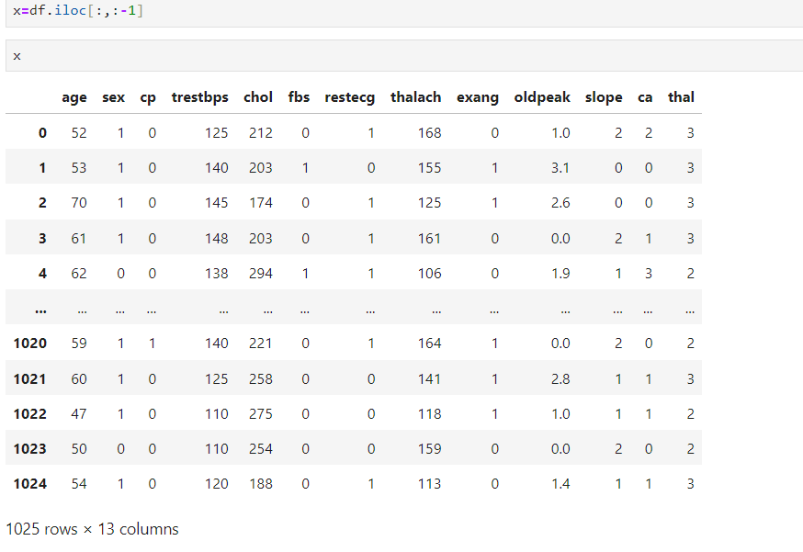
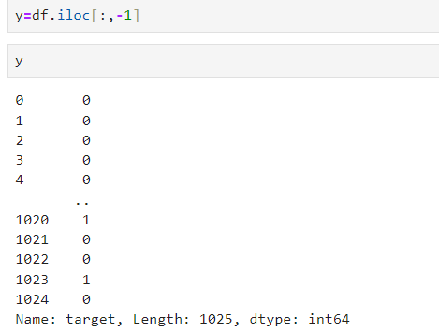
Model Training and Evaluation
Training-Test Split: Divided the dataset into 80% training and 20% testing.

Slide 11
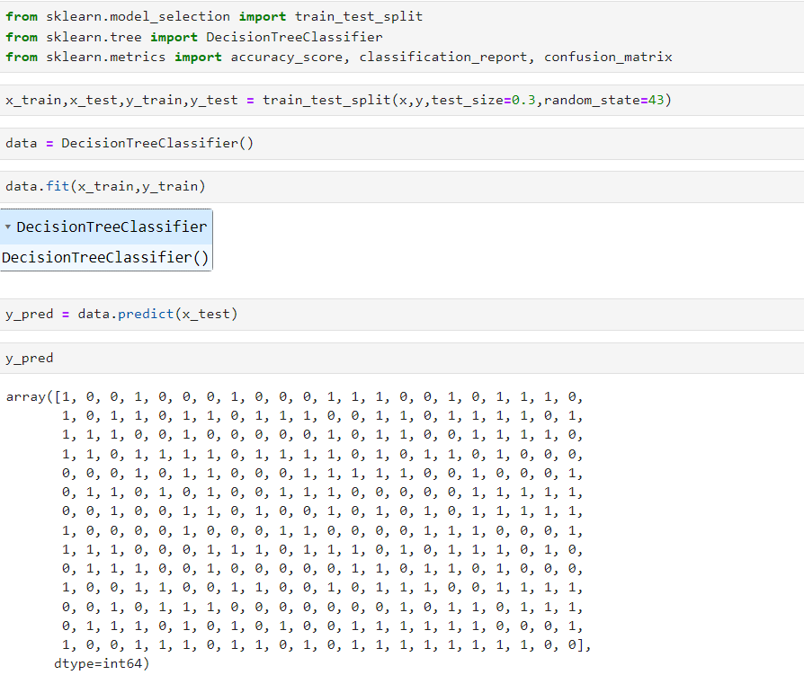

Slide 12
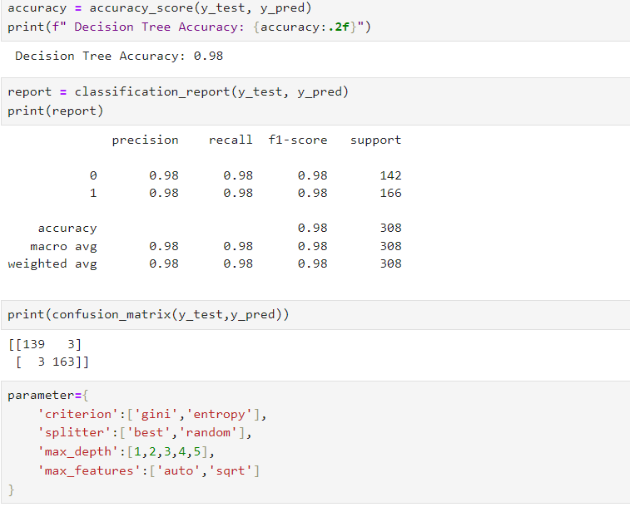
Evaluation Metrics:
Accuracy
Precision
Recall
F1 Score

Slide 13
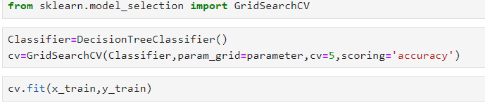
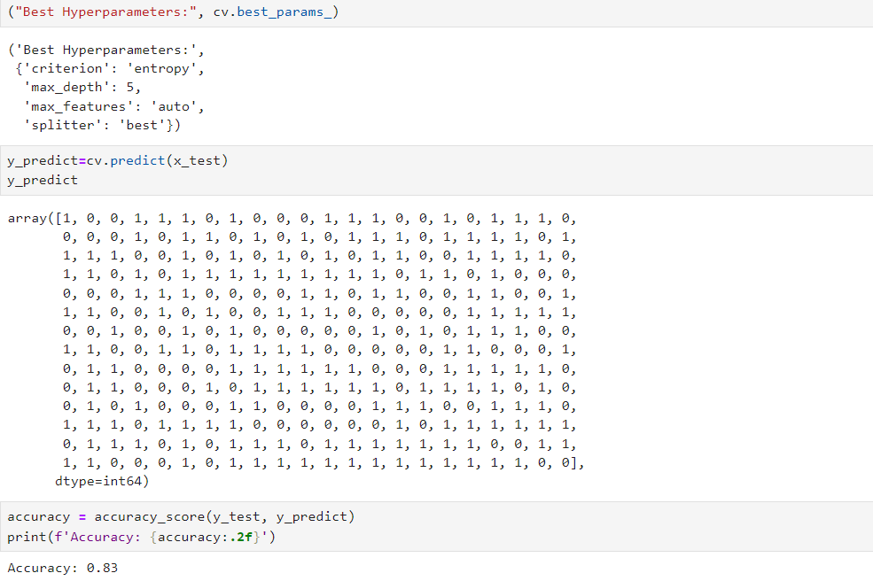

Slide 14
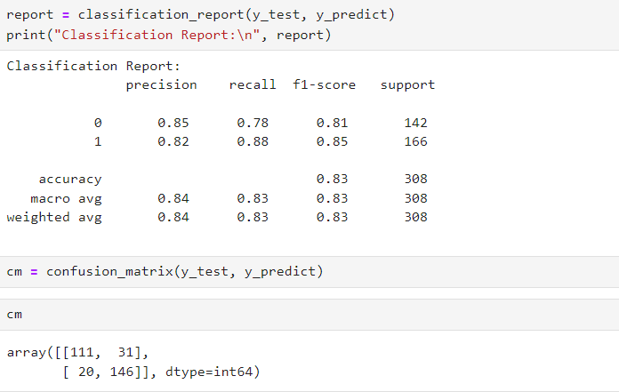

Slide 15
Regression
Regression in machine learning is a supervised learning technique used to predict continuous numeric values based on input features
Regression involves modeling the relationship between one or more independent variables (features) and a dependent variable (target) that is continuous.
Common Algorithms
Linear Regression:
Finds the best-fitting line through the data points using the least squares method.

Slide 16
Ridge and Lasso Regression:
Ridge: Adds L2 regularization to reduce model complexity.
Lasso: Adds L1 regularization, which can also perform feature selection.
Decision Tree Regression:
Creates a tree structure where each leaf represents a predicted value based on feature splits.
Random Forest Regression:
Combines multiple decision trees to enhance accuracy and reduce overfitting.

Slide 17
Applications
Real Estate: Predicting property prices based on features like location, size, and amenities.
Finance: Estimating stock prices, returns, or risk metrics.
Healthcare: Predicting patient outcomes based on various health indicators.
Sales Forecasting: Estimating future sales based on historical data.

Slide 18
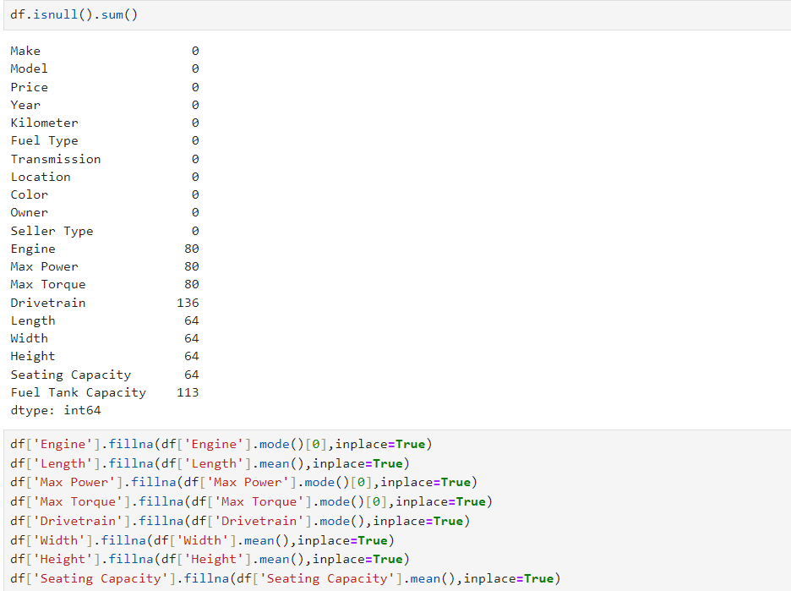
Regression: Car Price Prediction
Data Preprocessing
Handling Missing Values: Addressed missing entries appropriately.

Slide 19
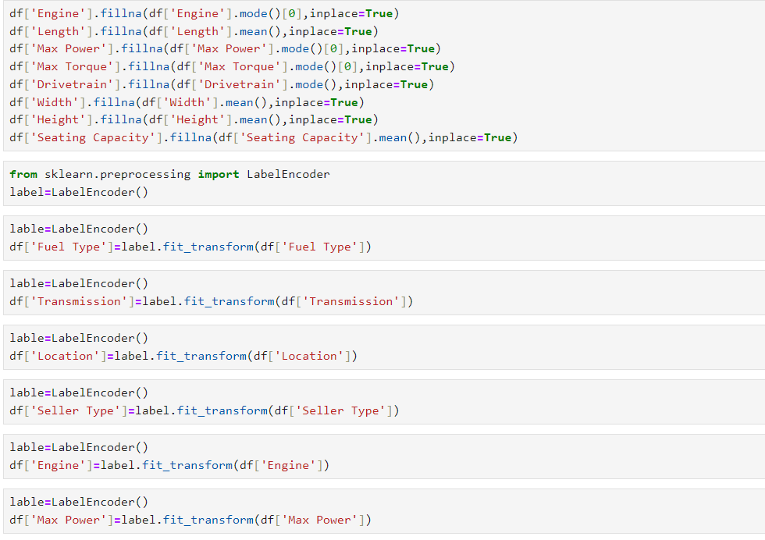
Encoding Categorical Variables:
Applied label encoding for ordinal variables (e.g., year).

Slide 20
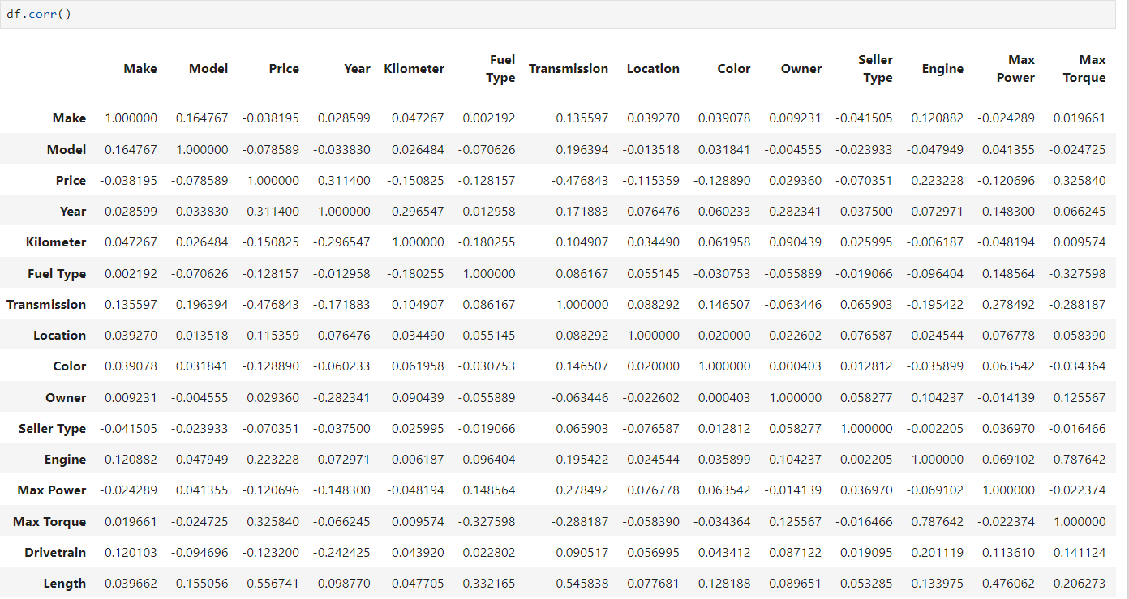
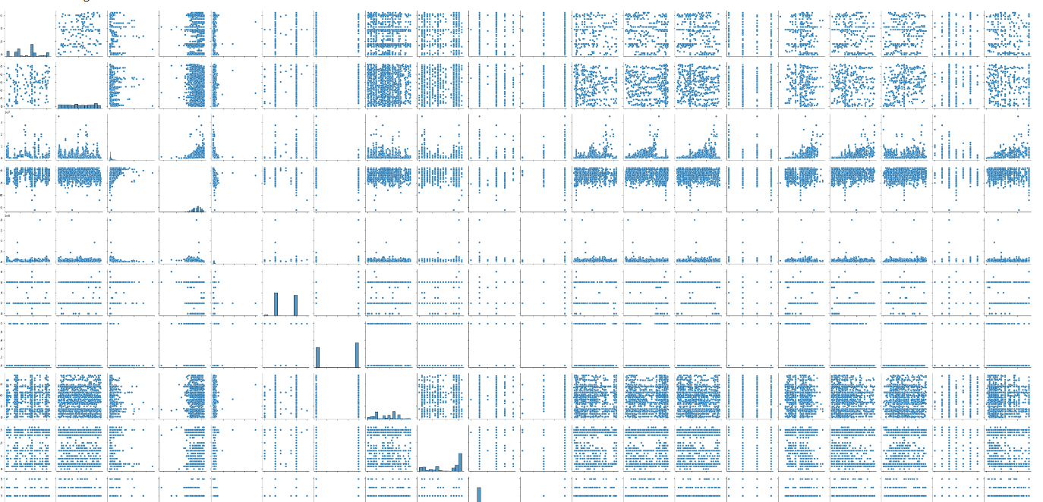
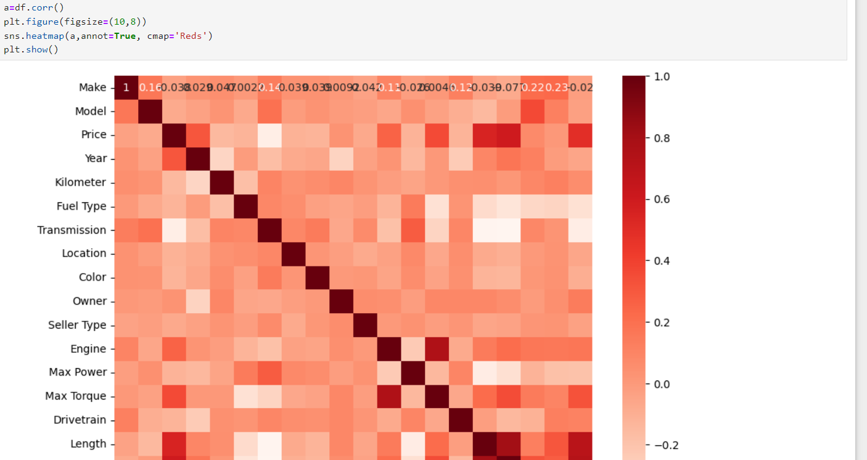

Slide 21
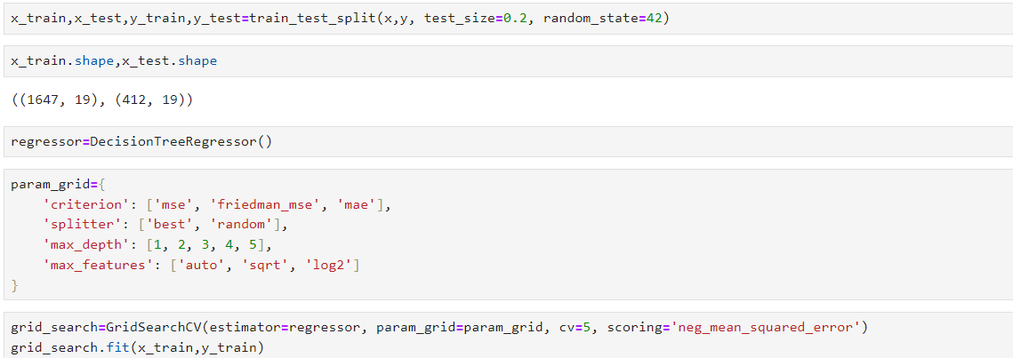
Model Training and Evaluation
Training-Test Split: Divided the dataset into 80% training and 20% testing.
Evaluation Metrics:
Mean Absolute Error (MAE)
Mean Squared Error (MSE)
Root Mean Squared Error (RMSE)
R-squared (R²)

Slide 22
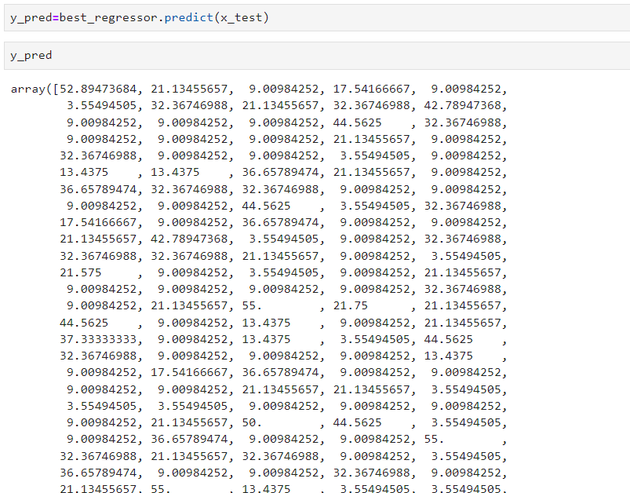
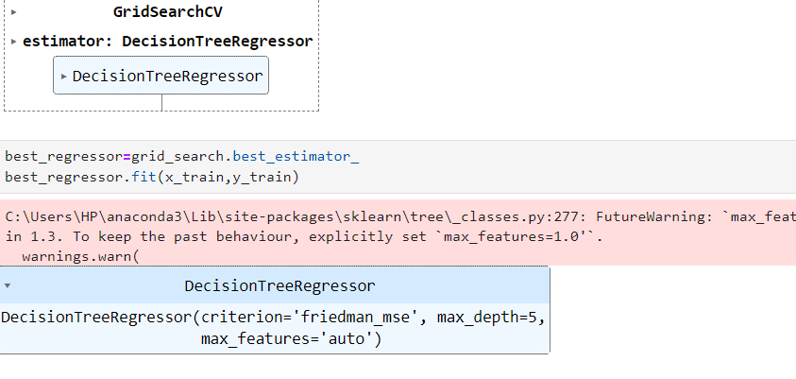

Slide 23
